Slide 1



ASCEND
Arizona State University
2017-2018

Slide 2
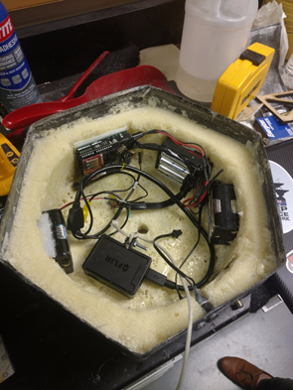
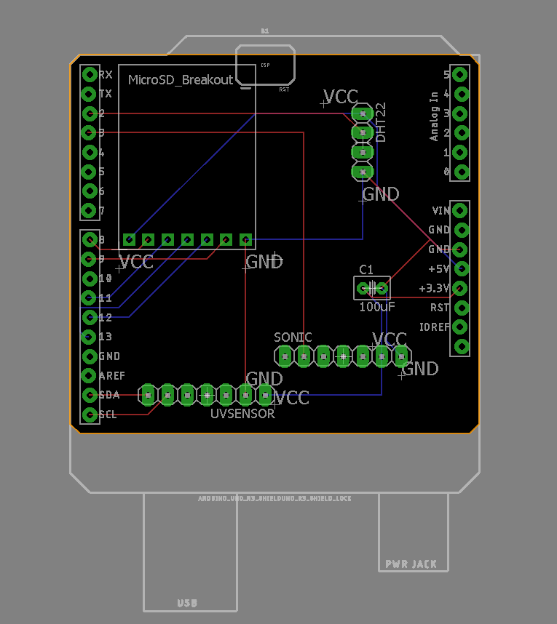
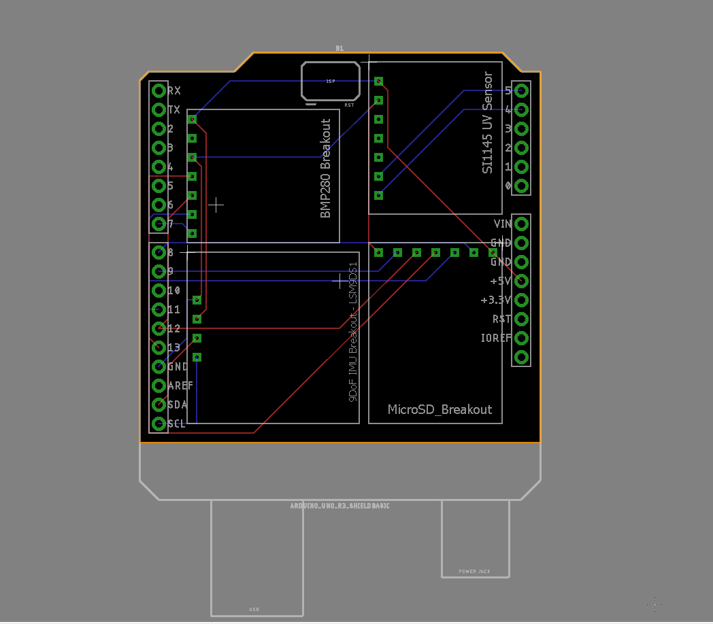
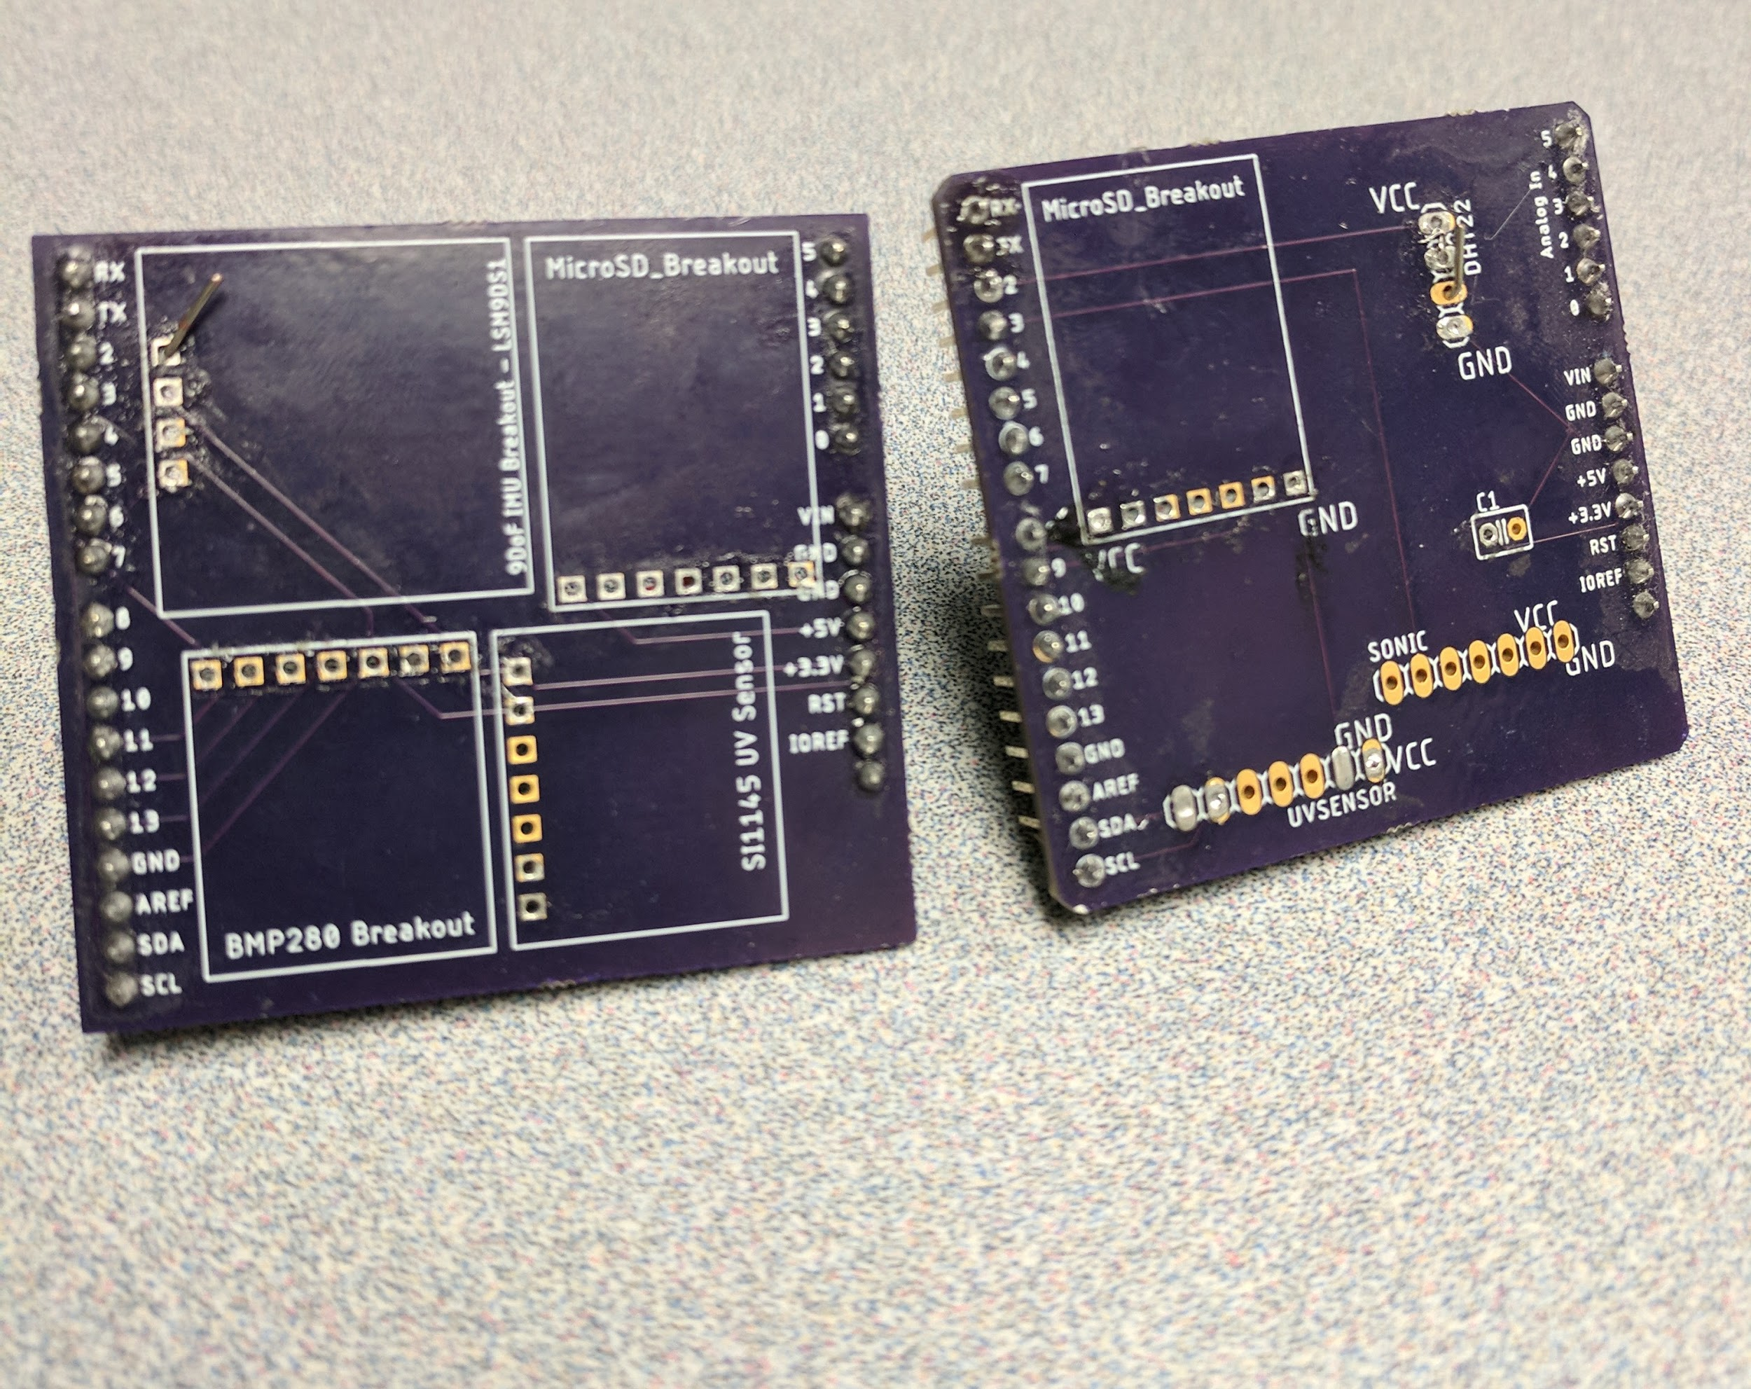
Fall Circuit Designs
Student designed PCB’s in Eagle CAD
Key switch system to turn on:
  2 Arduino Uno’s
  1 Camera

Slide 3
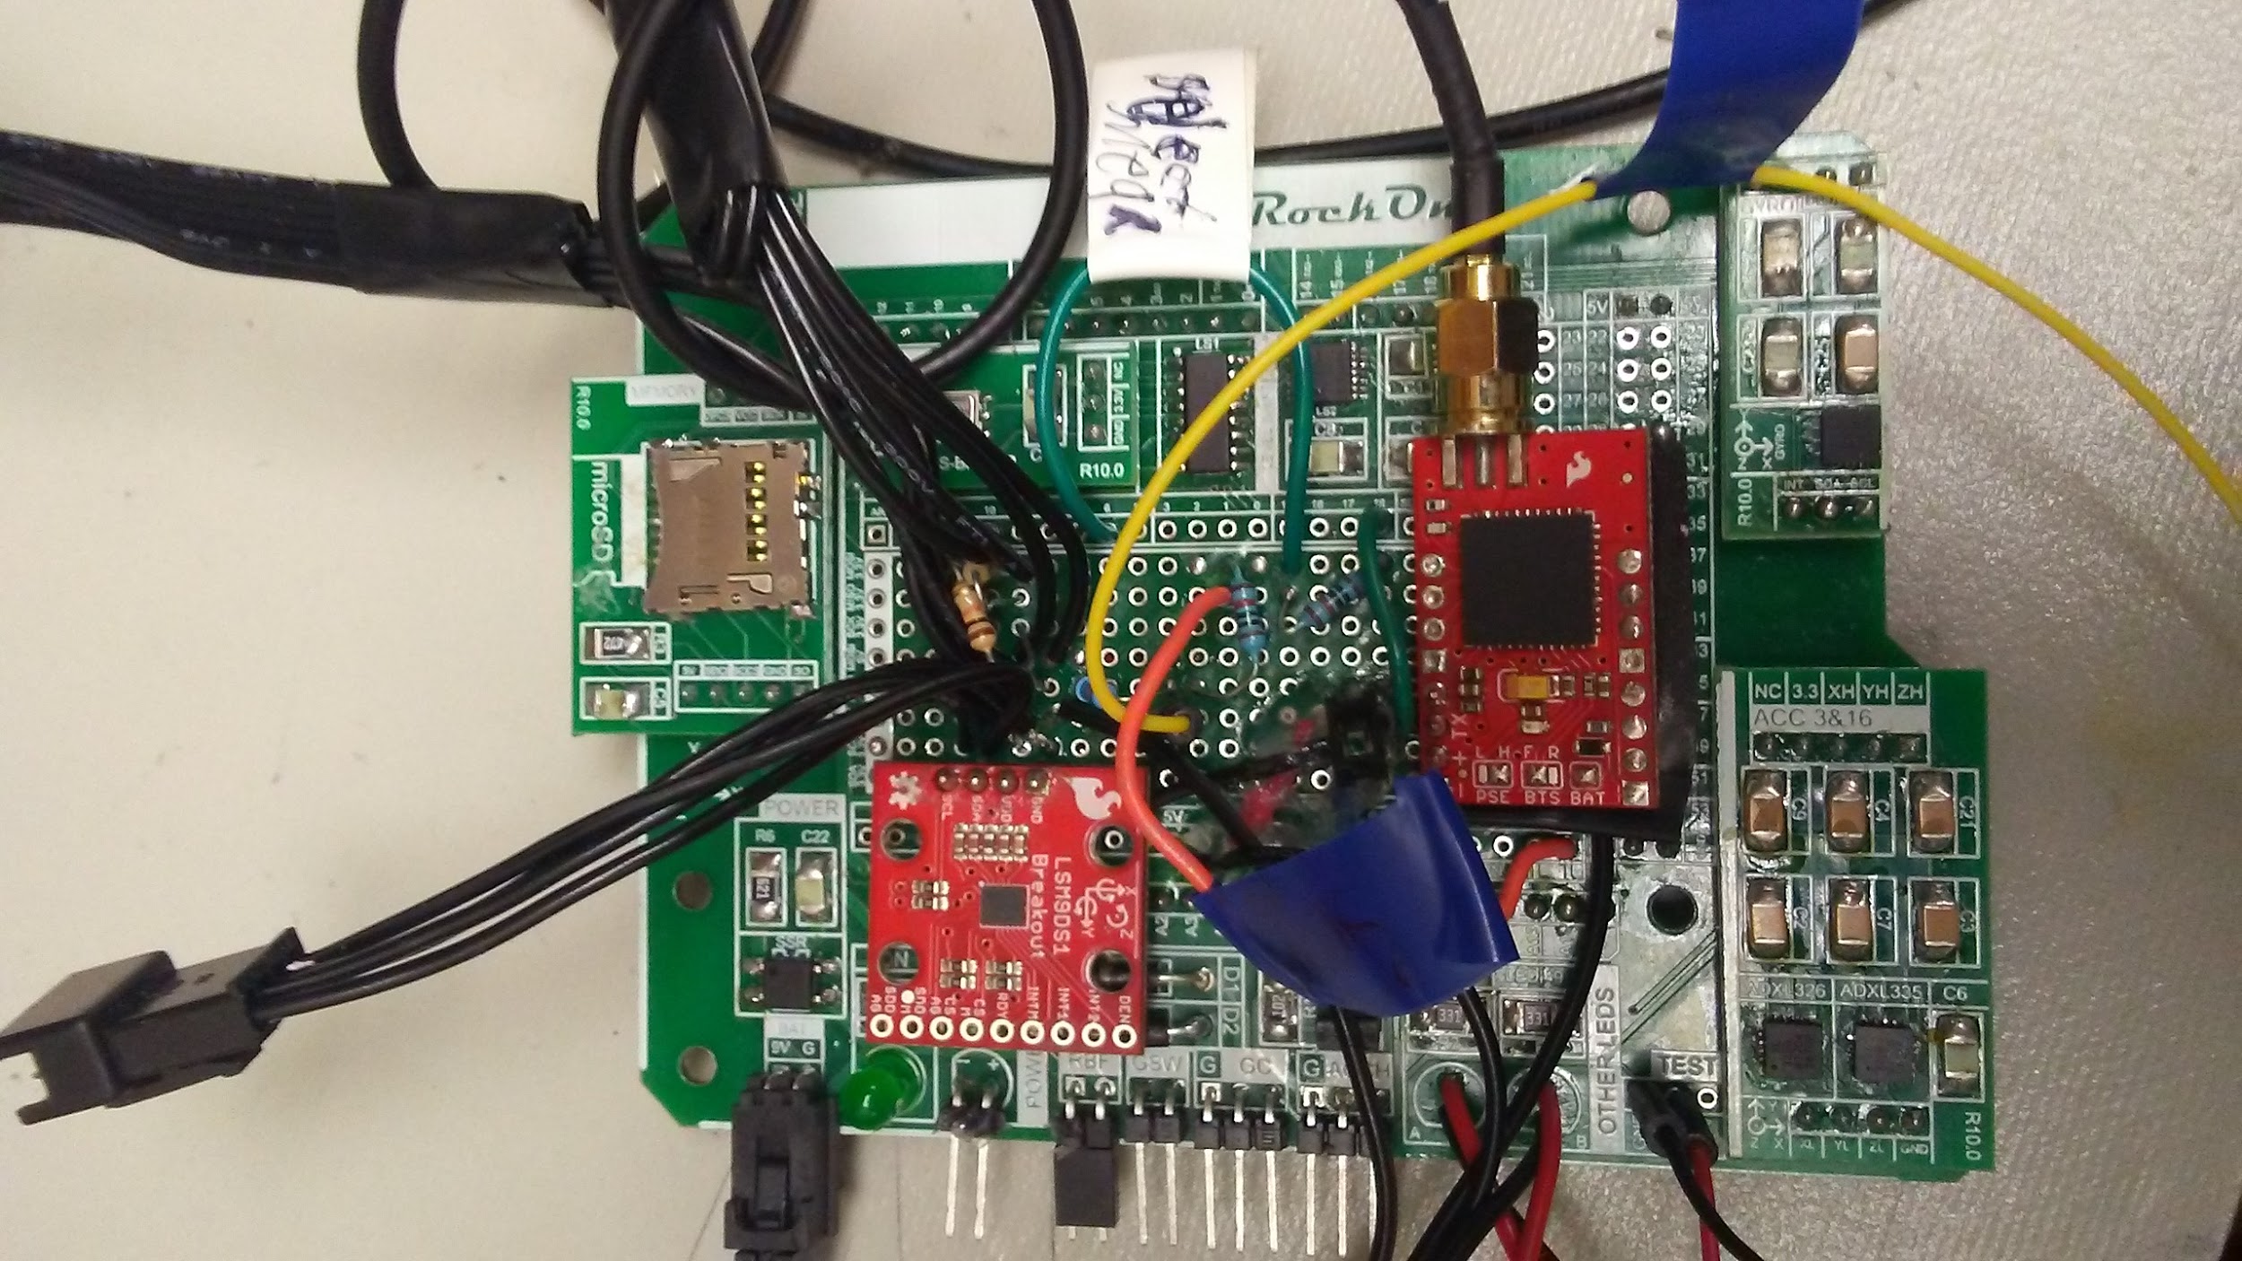
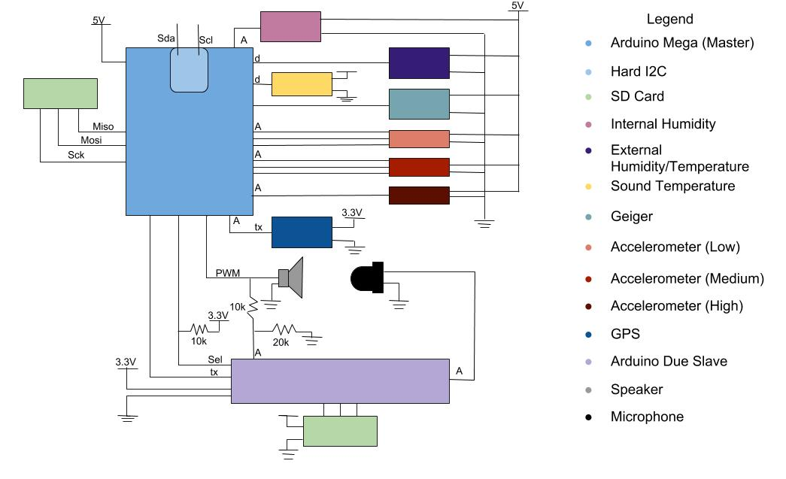
Spring Circuit Designs
Repurposed RockOn PCB for ASCEND flight
Primed
Separated Speed of Sound from bulk of electronics
Power to shield
Blinking = Logging

Slide 4
Mechanical Goals
Create an enclosure that can withstand the elements throughout the flight
Reduce the weight of the enclosure
Create a standard payload that is reusable from launch to launch.
Test structural capabilities through simulations & trial drops
Experimenting with different insulation types
Design a rotation stabilization system

Slide 5
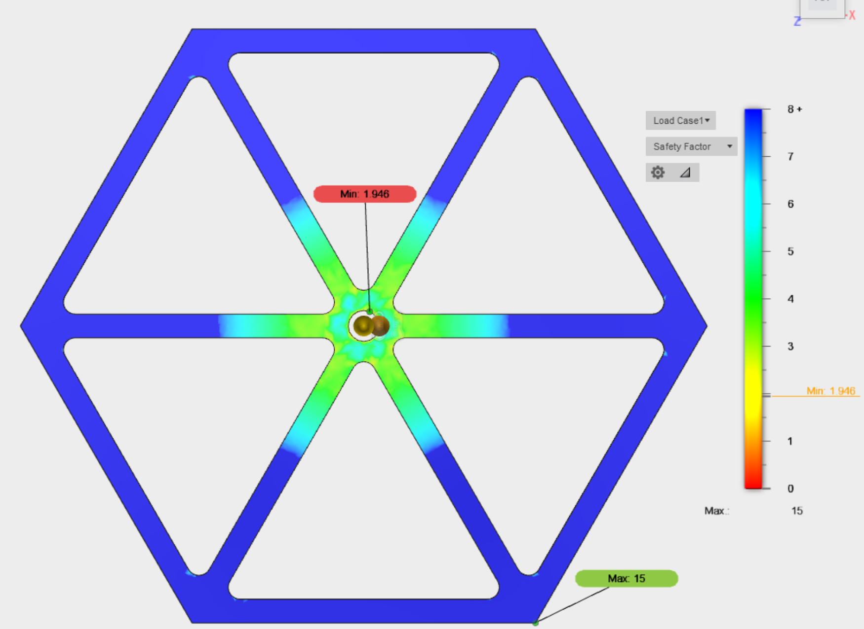
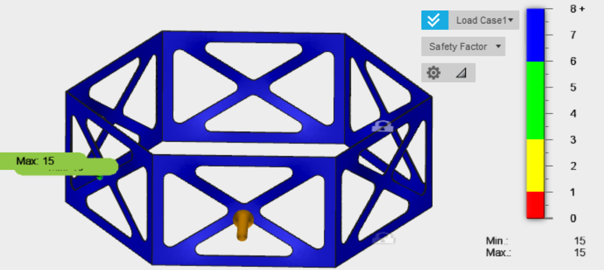
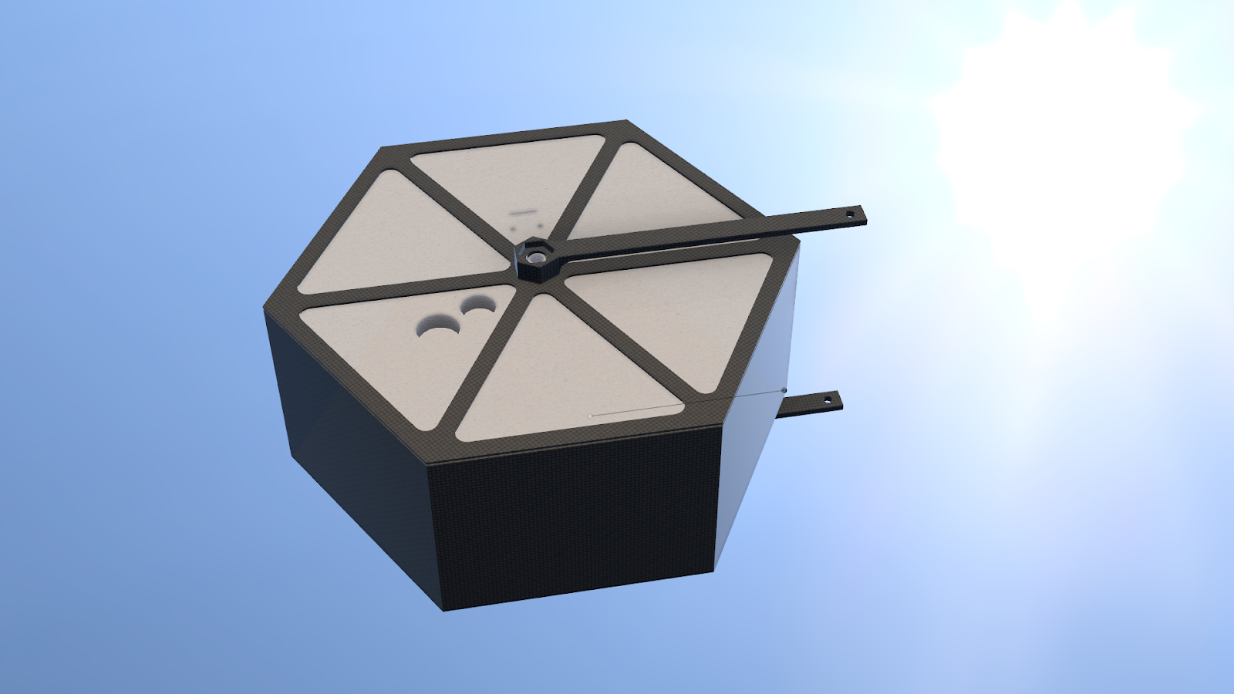
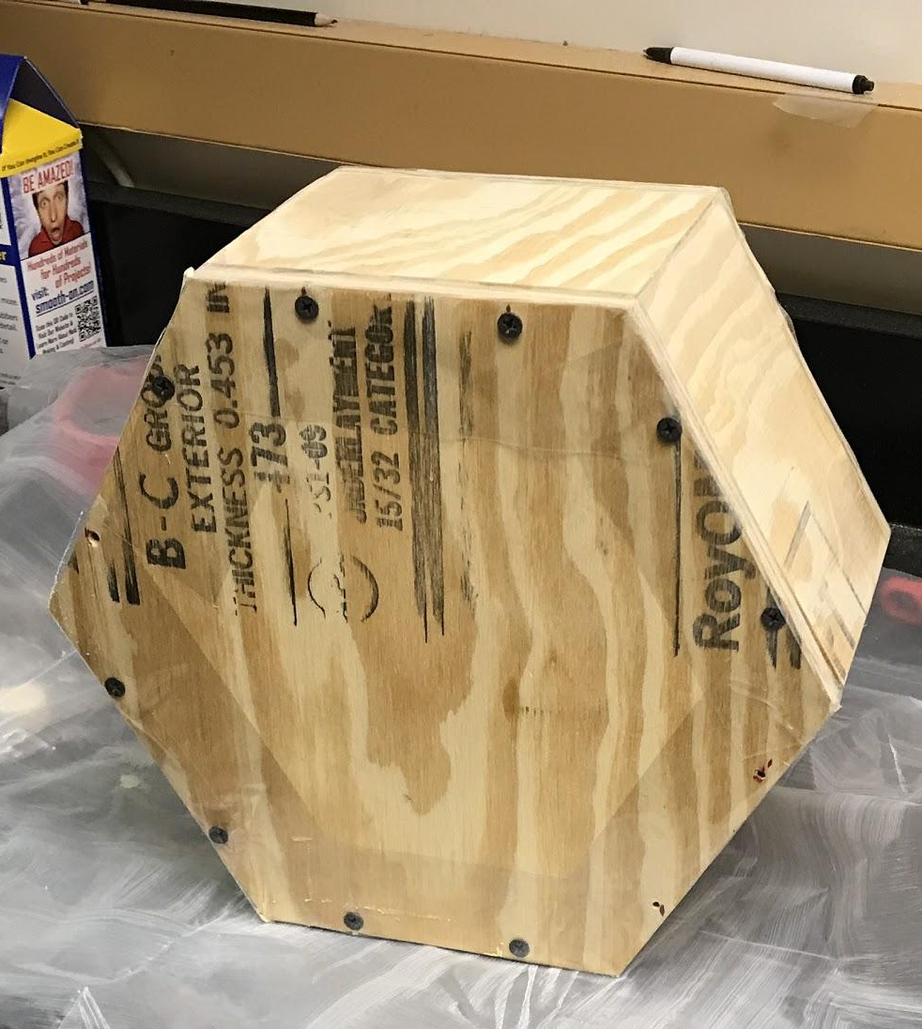
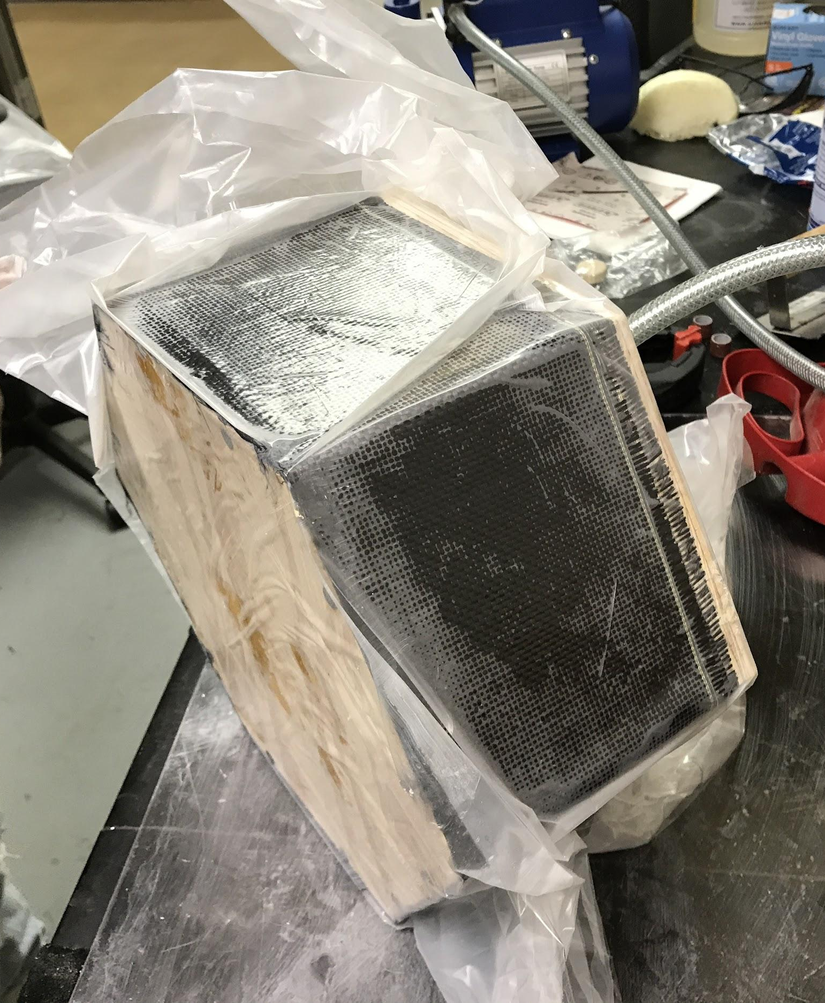
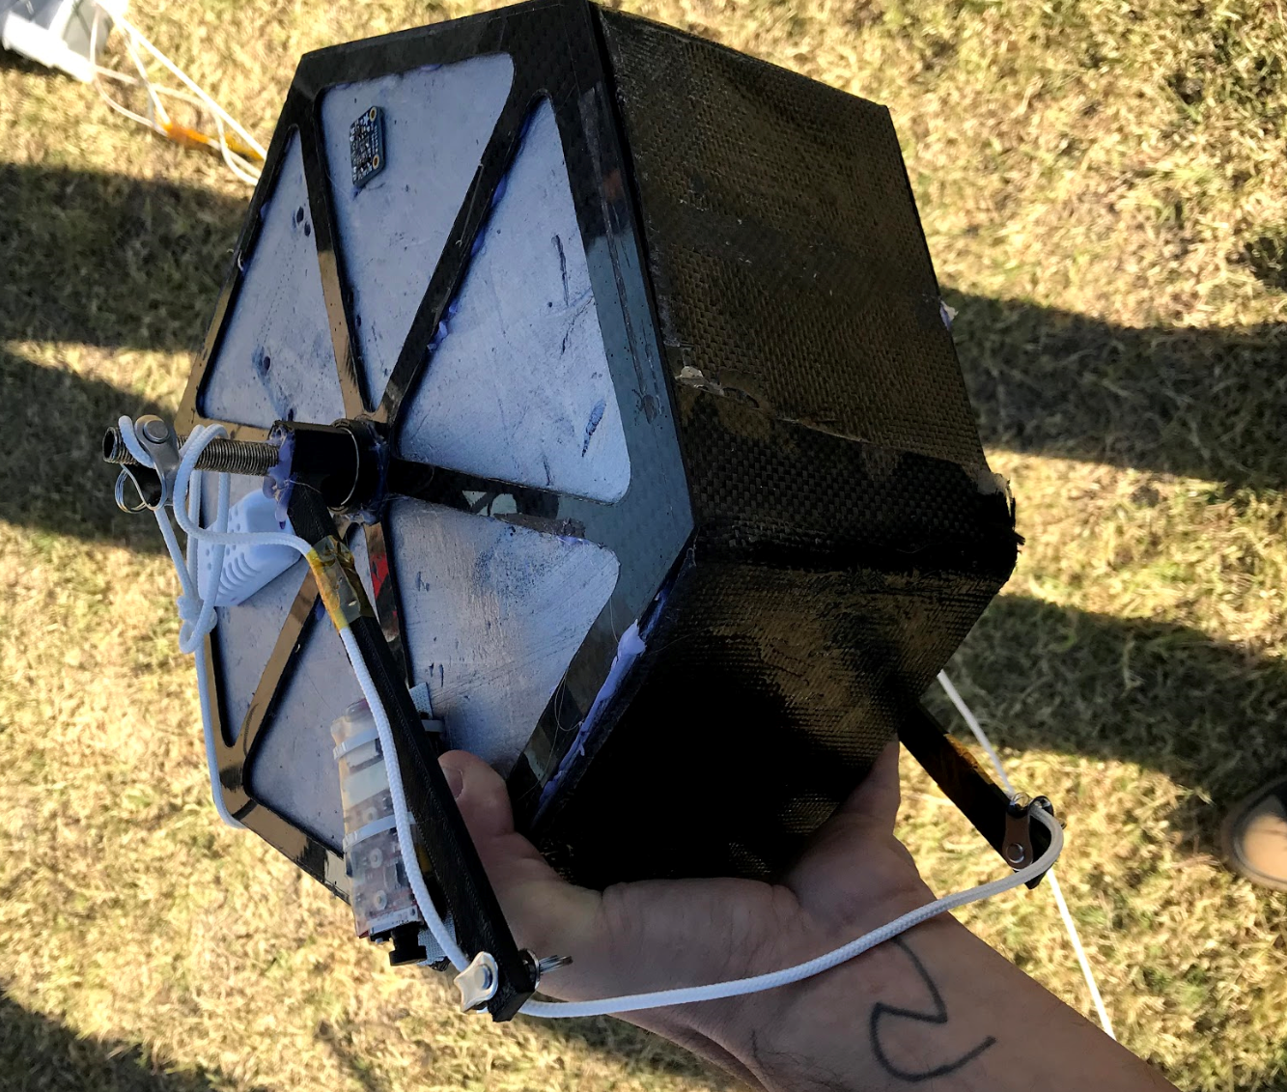
Fall Mechanical Engineering Process

Slide 6
Fall Mechanical Engineering Process
The analysis lets us know how
likely it is to break(safety factor)
Thus we can have more or
less CF layers dependant on the amount of stress.
This allows us to save weight
& material without compromising strength

Slide 7
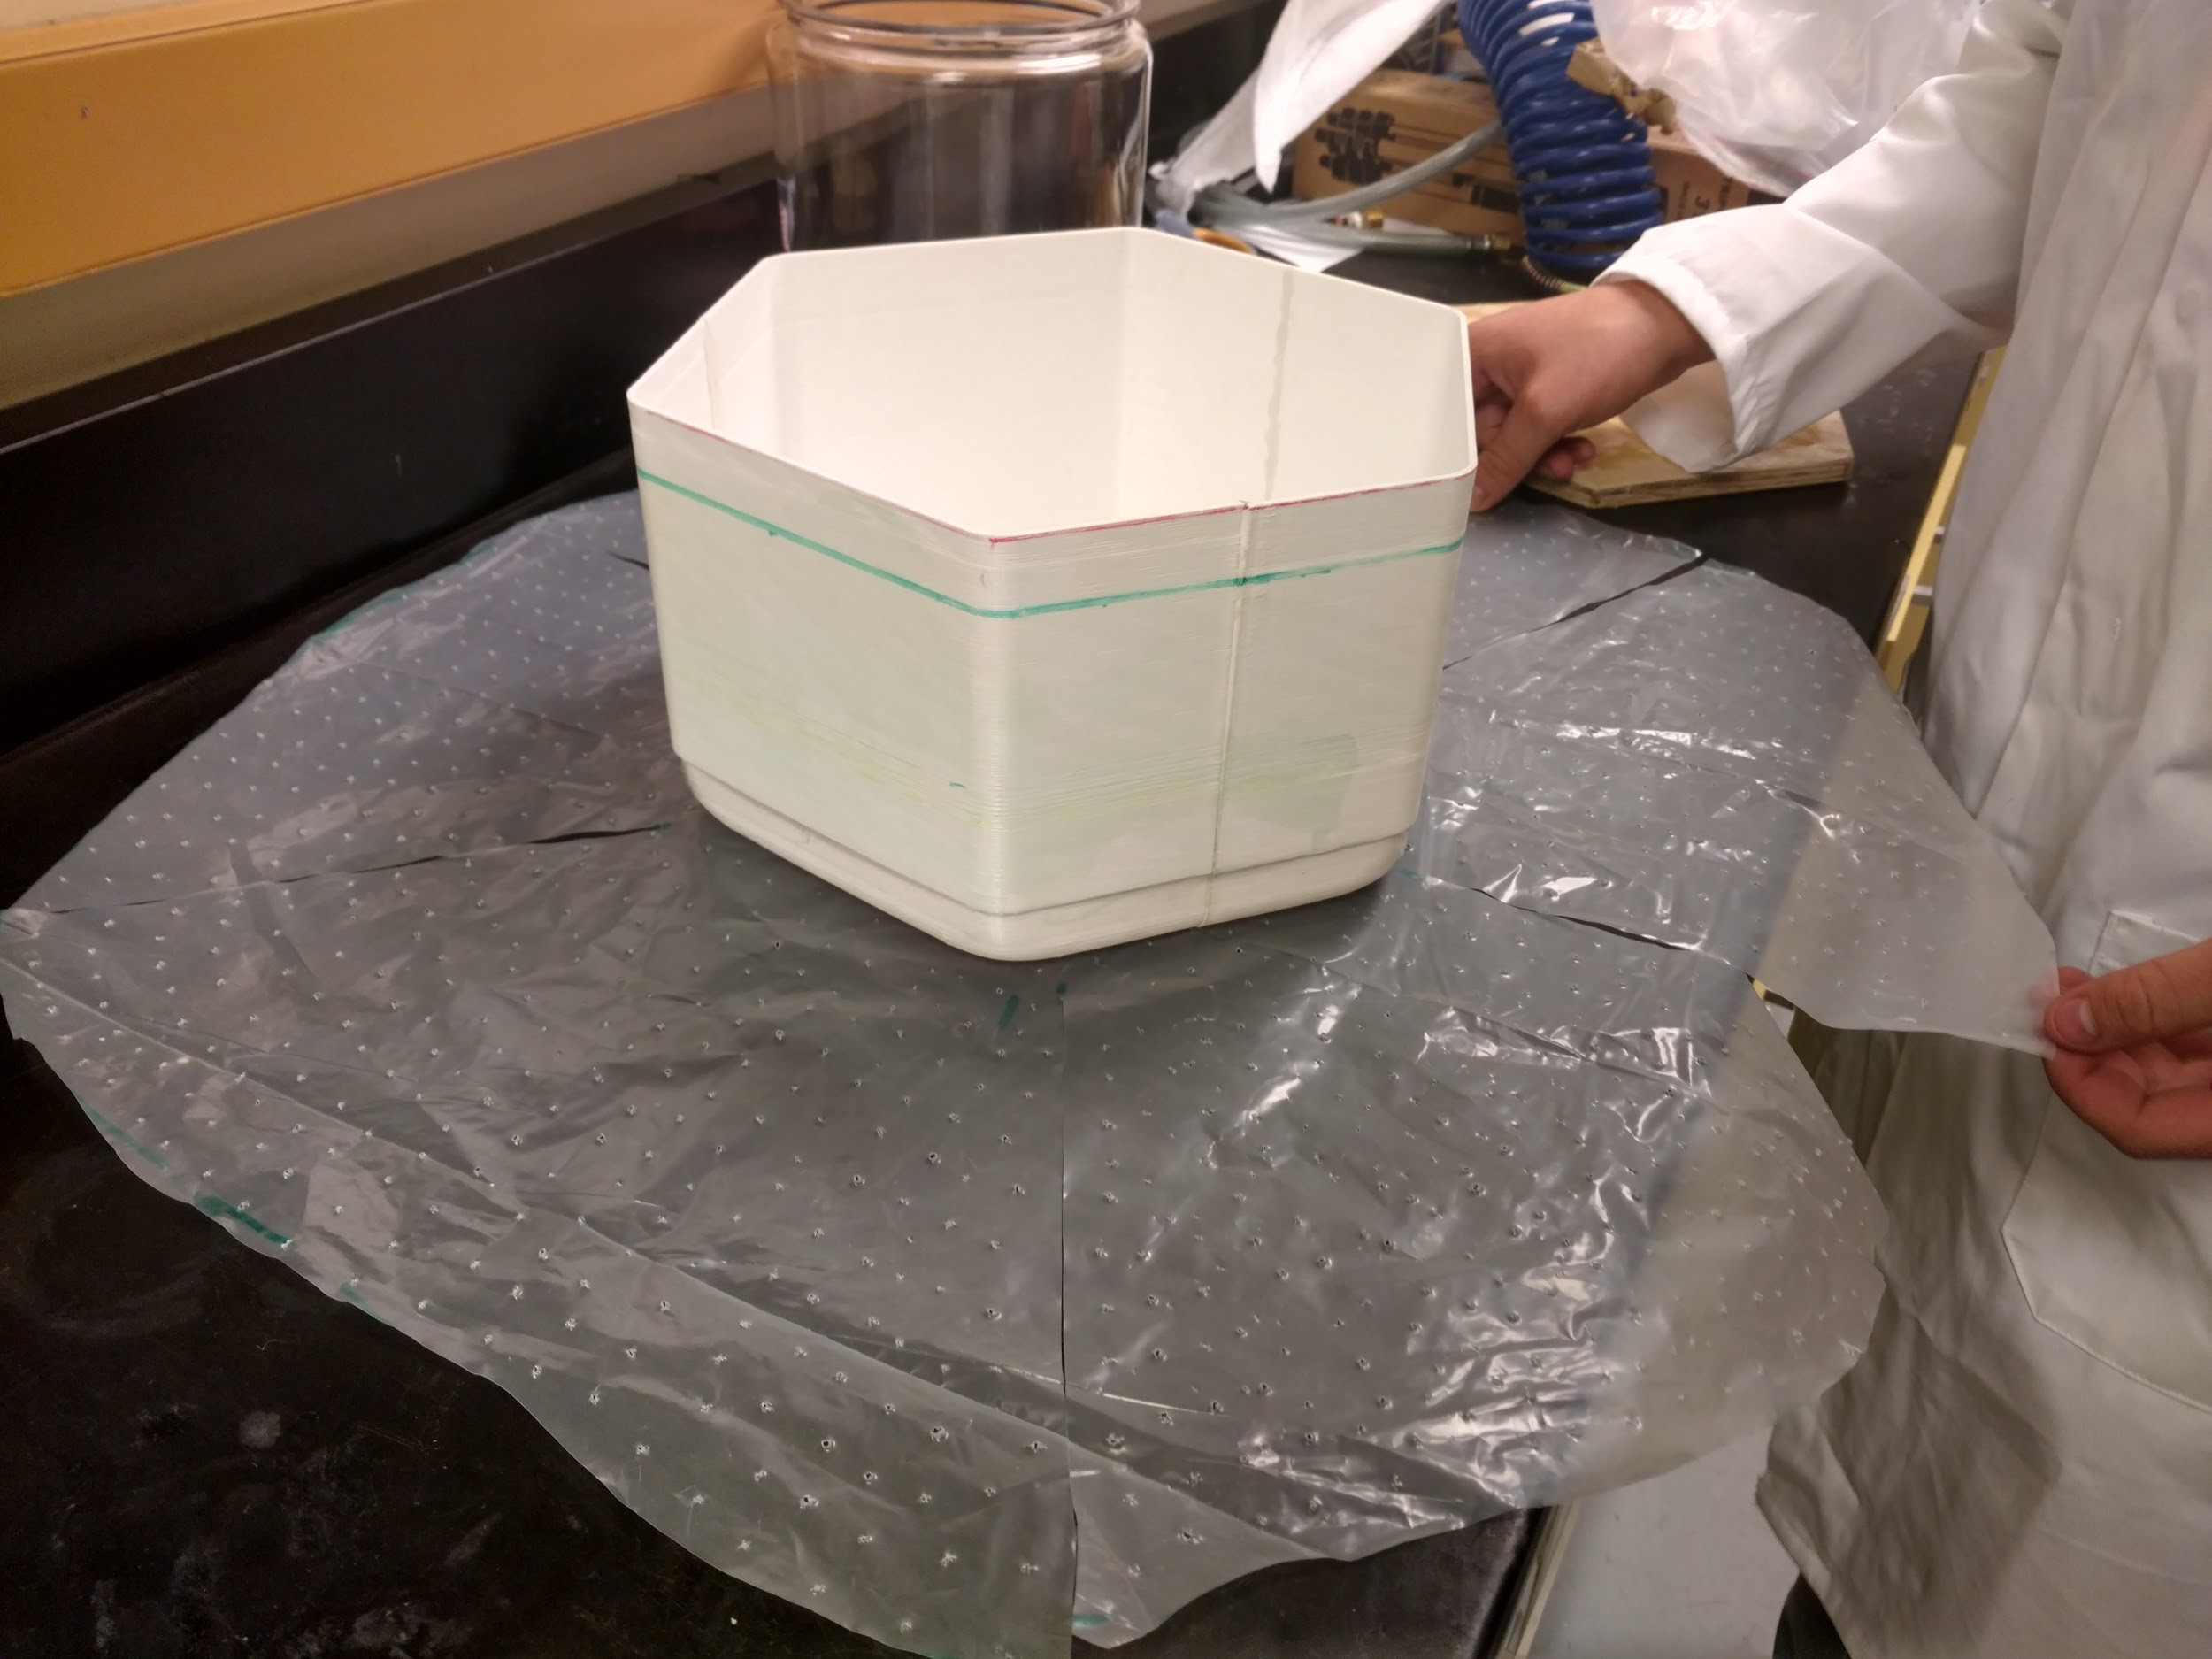
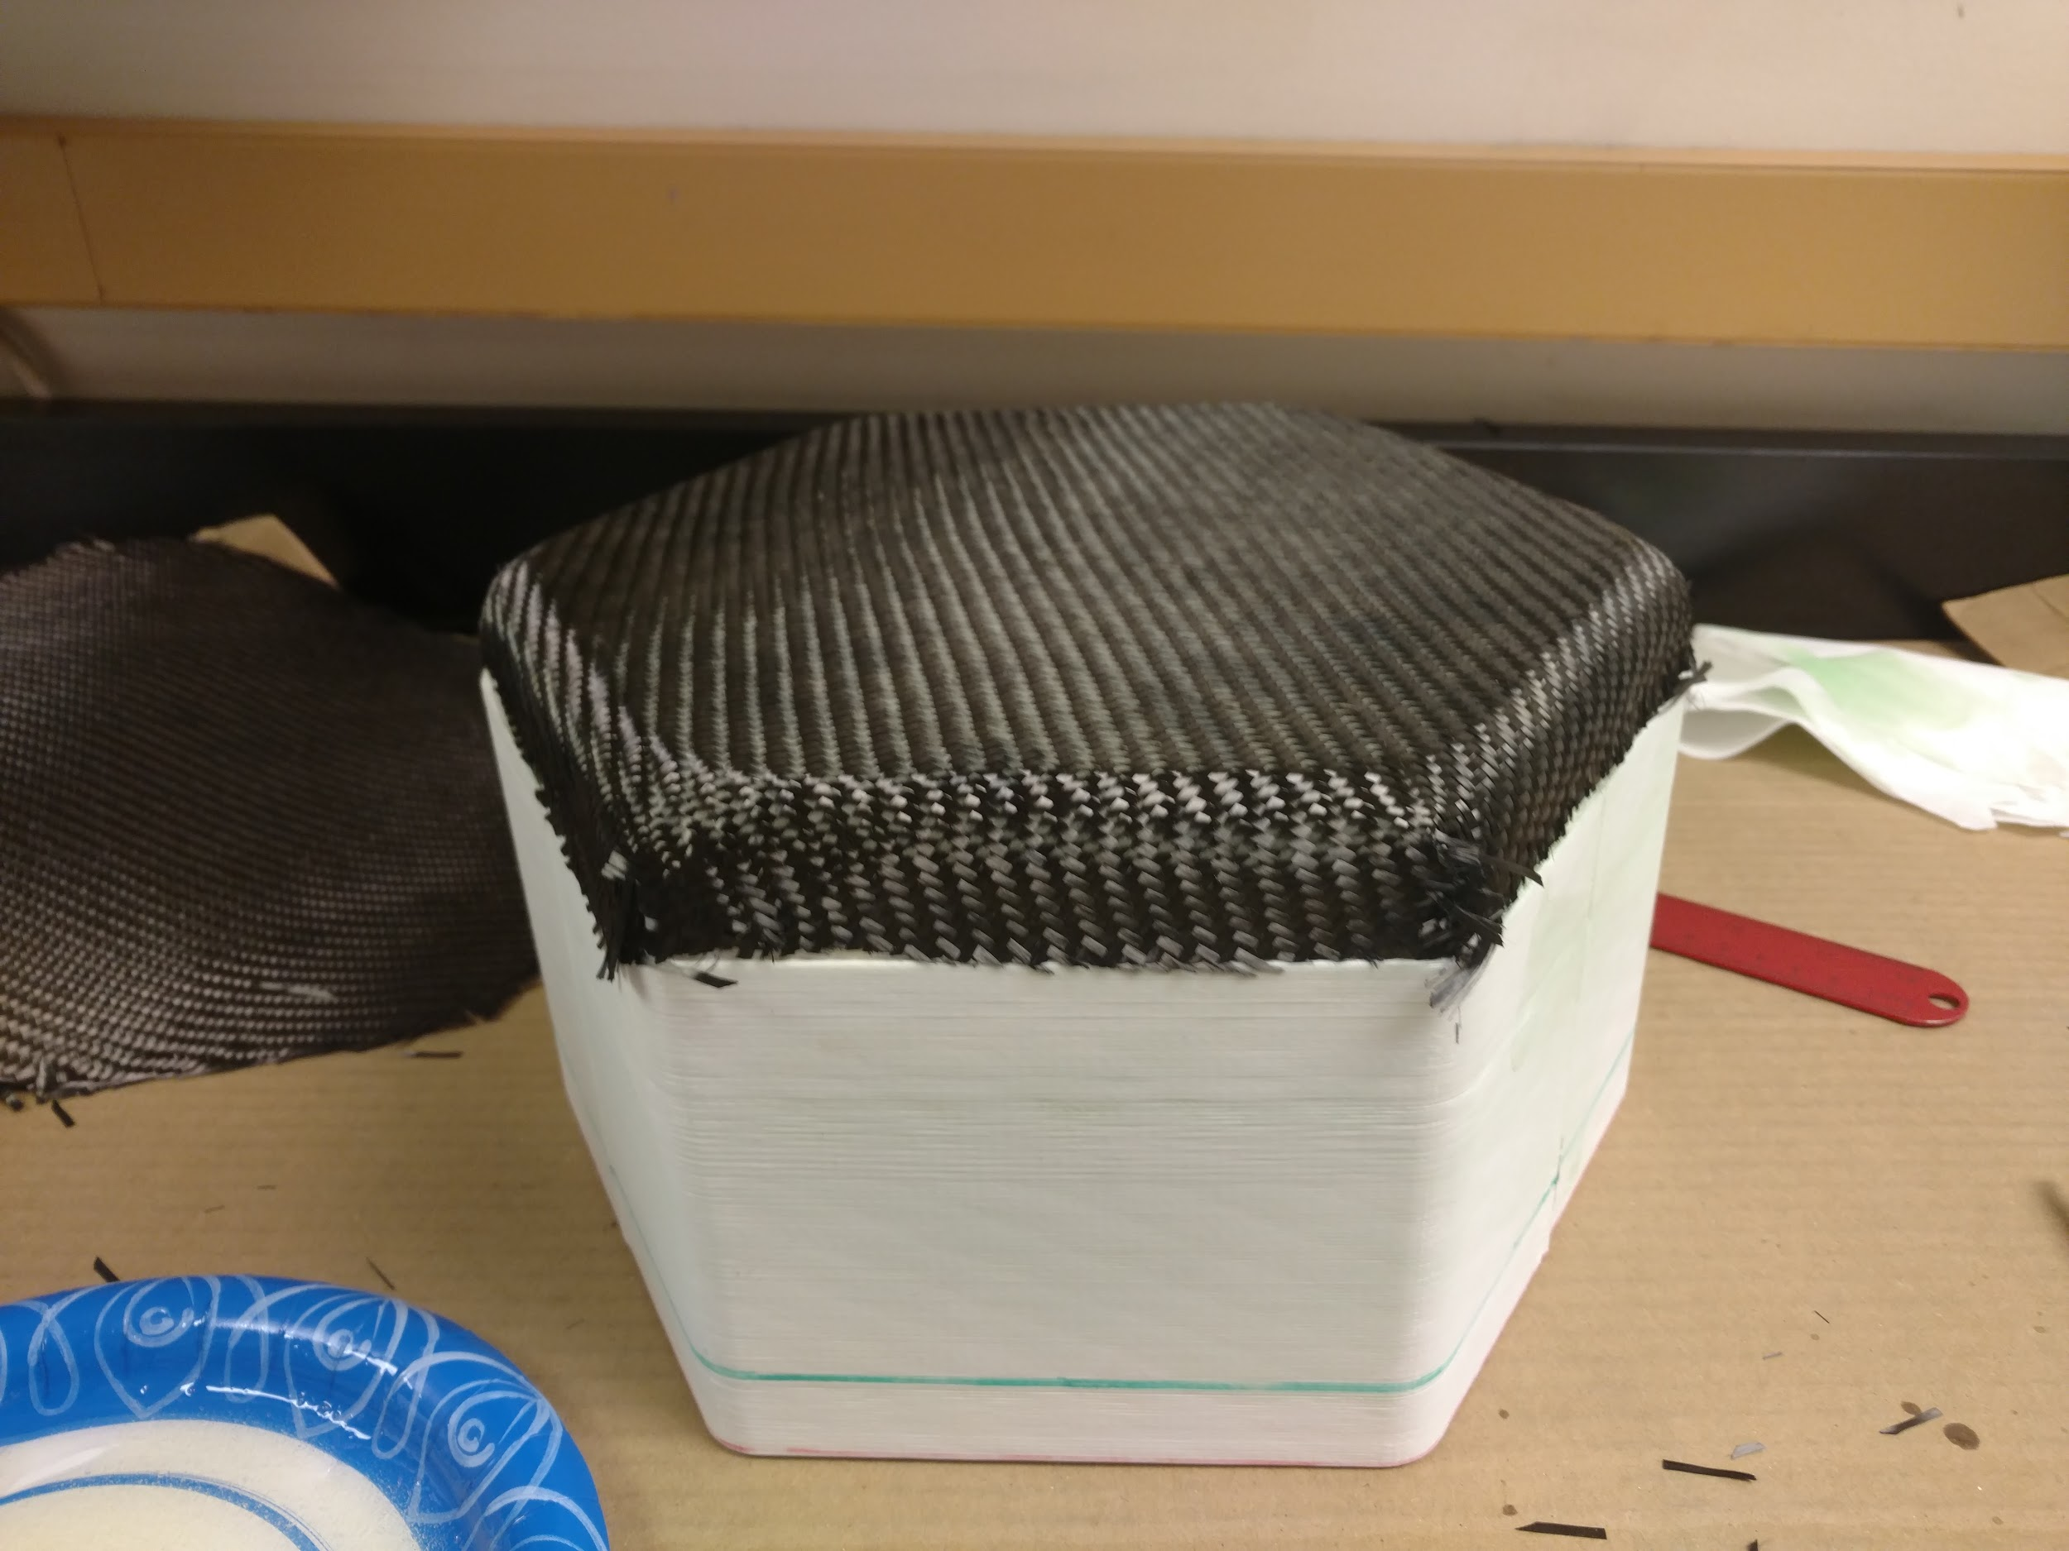
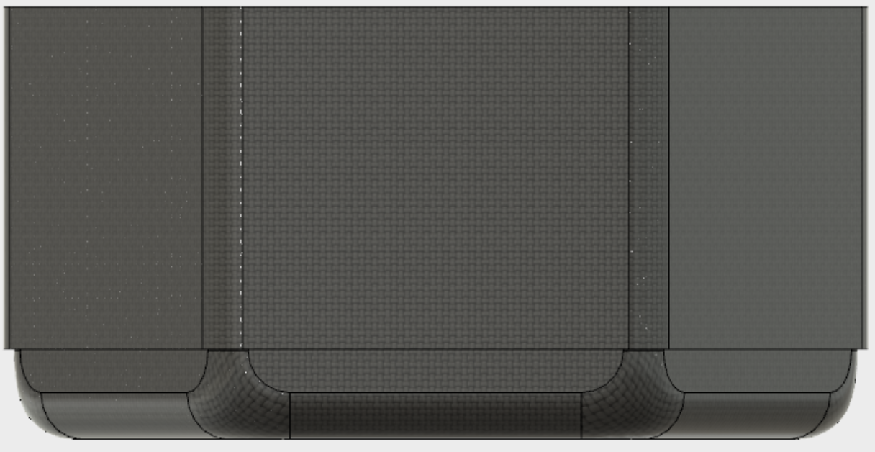
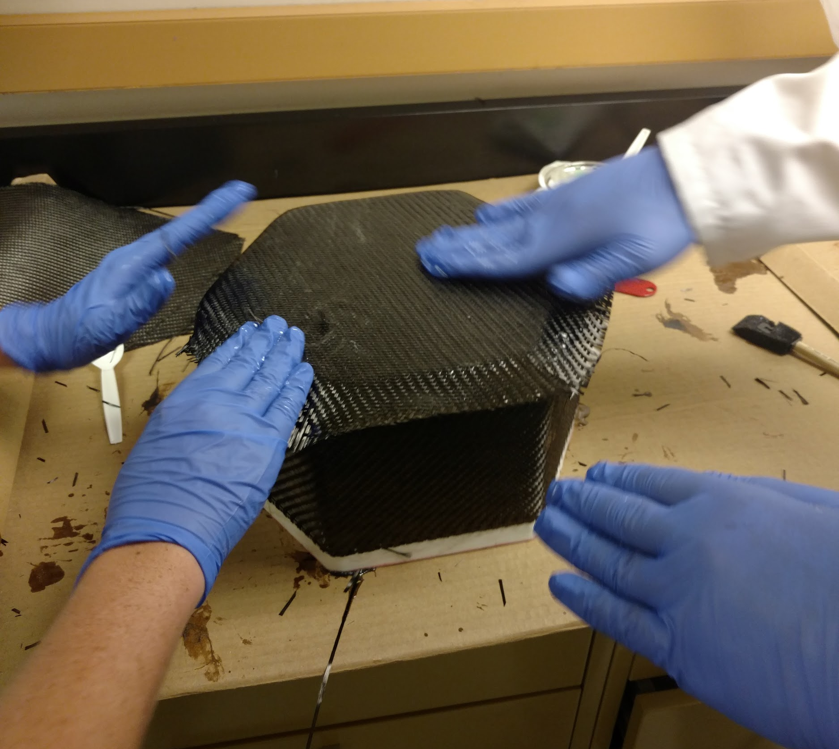
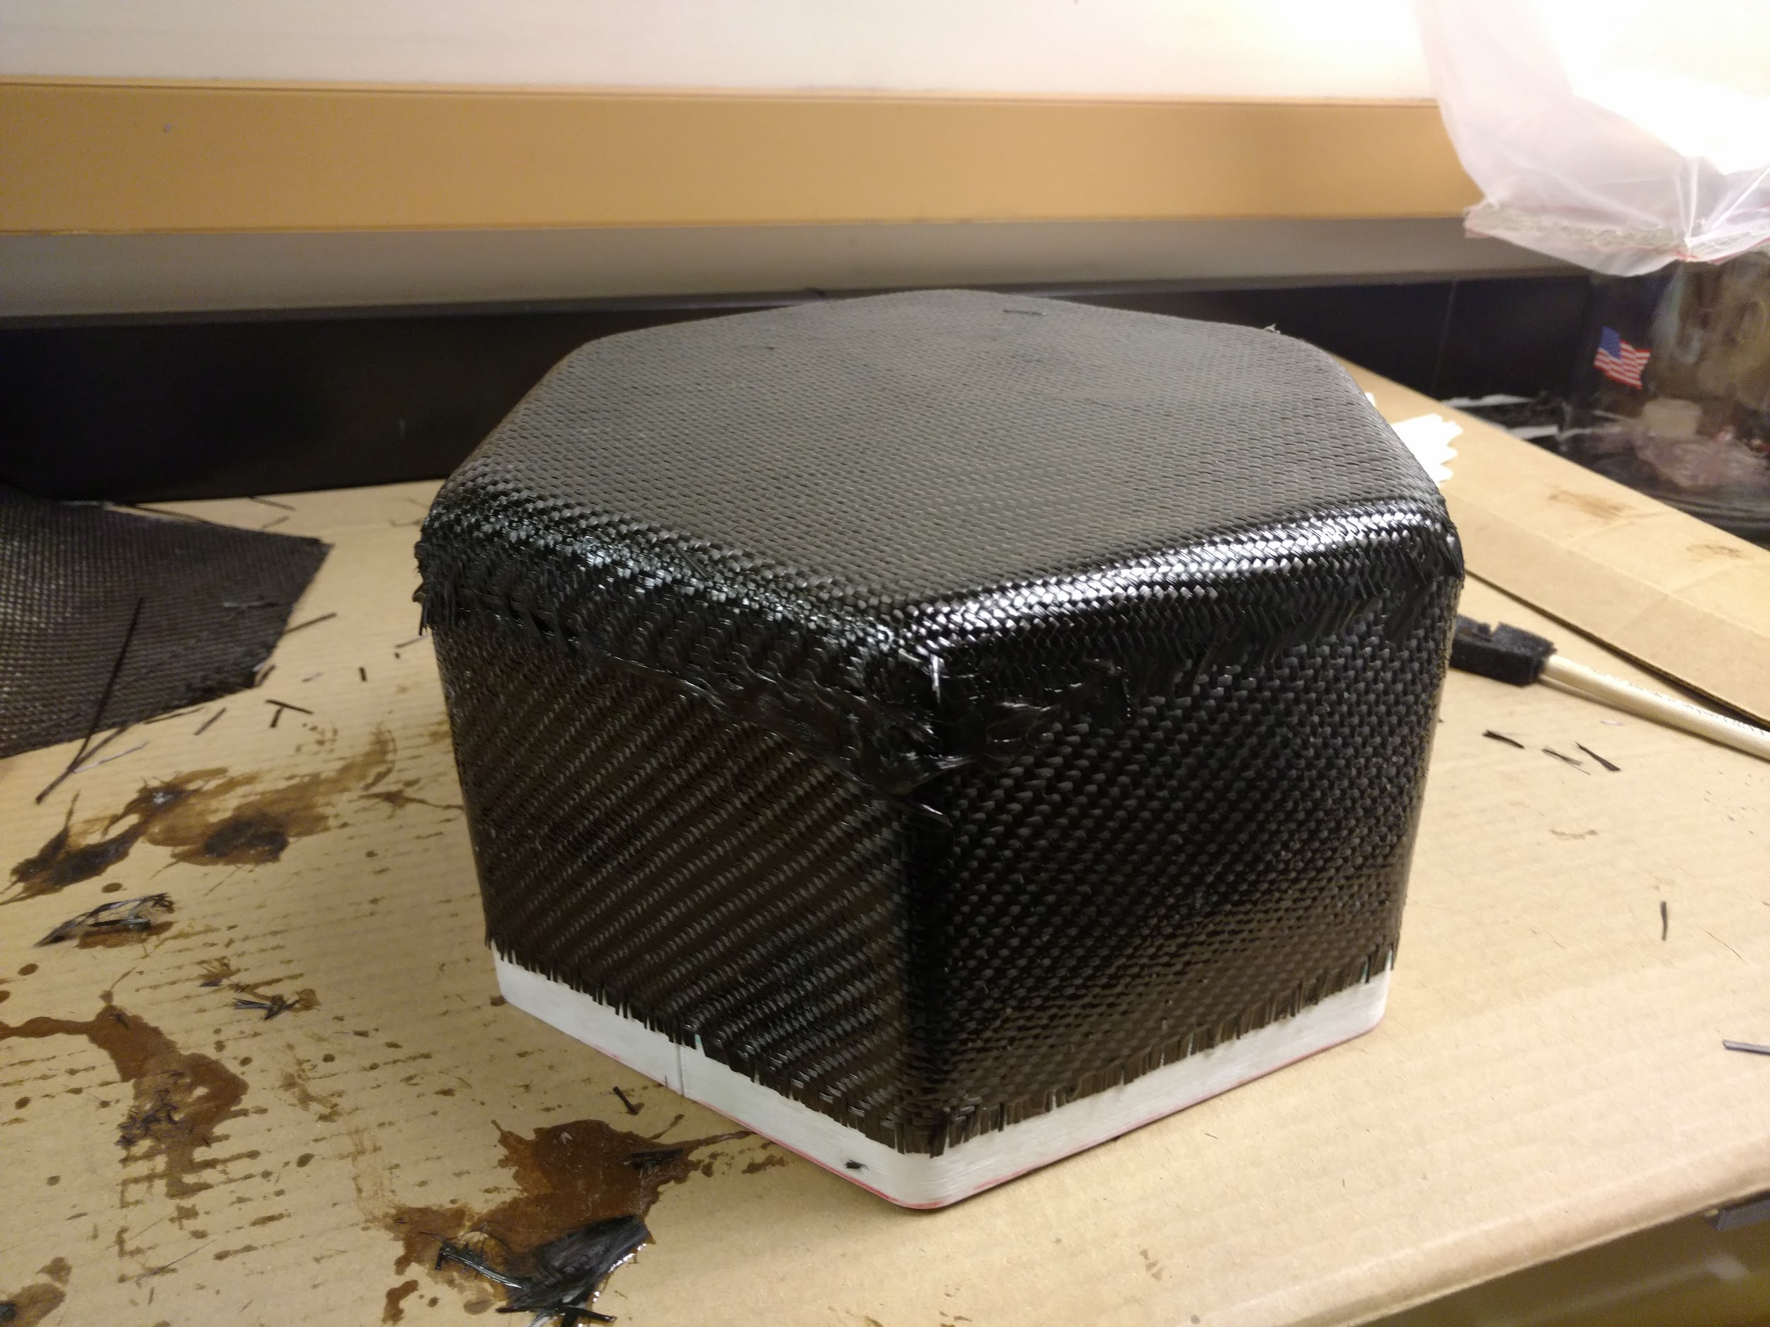
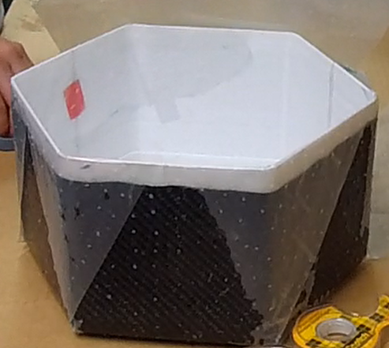
Spring Mechanical Engineering Process

Slide 8
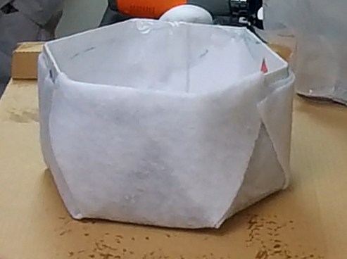
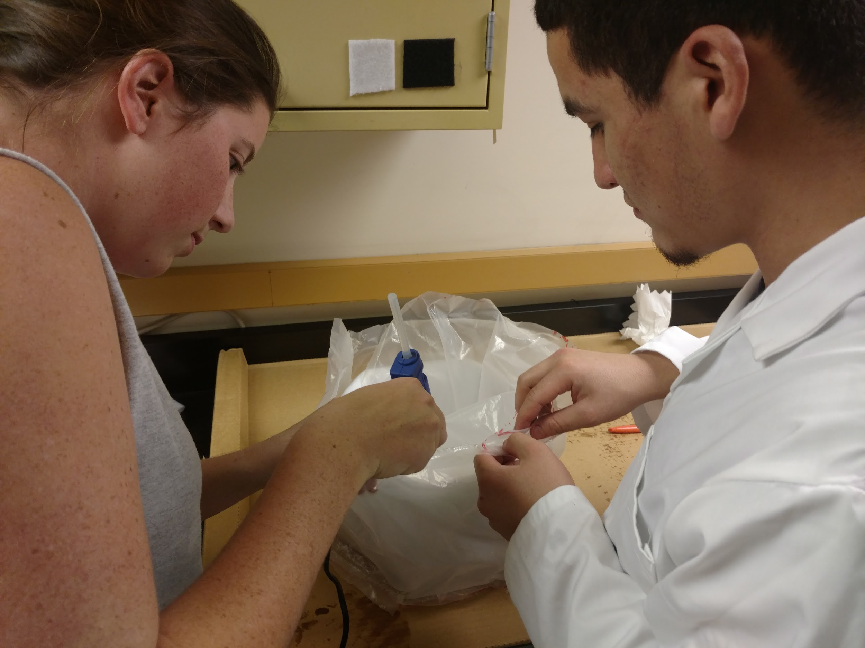
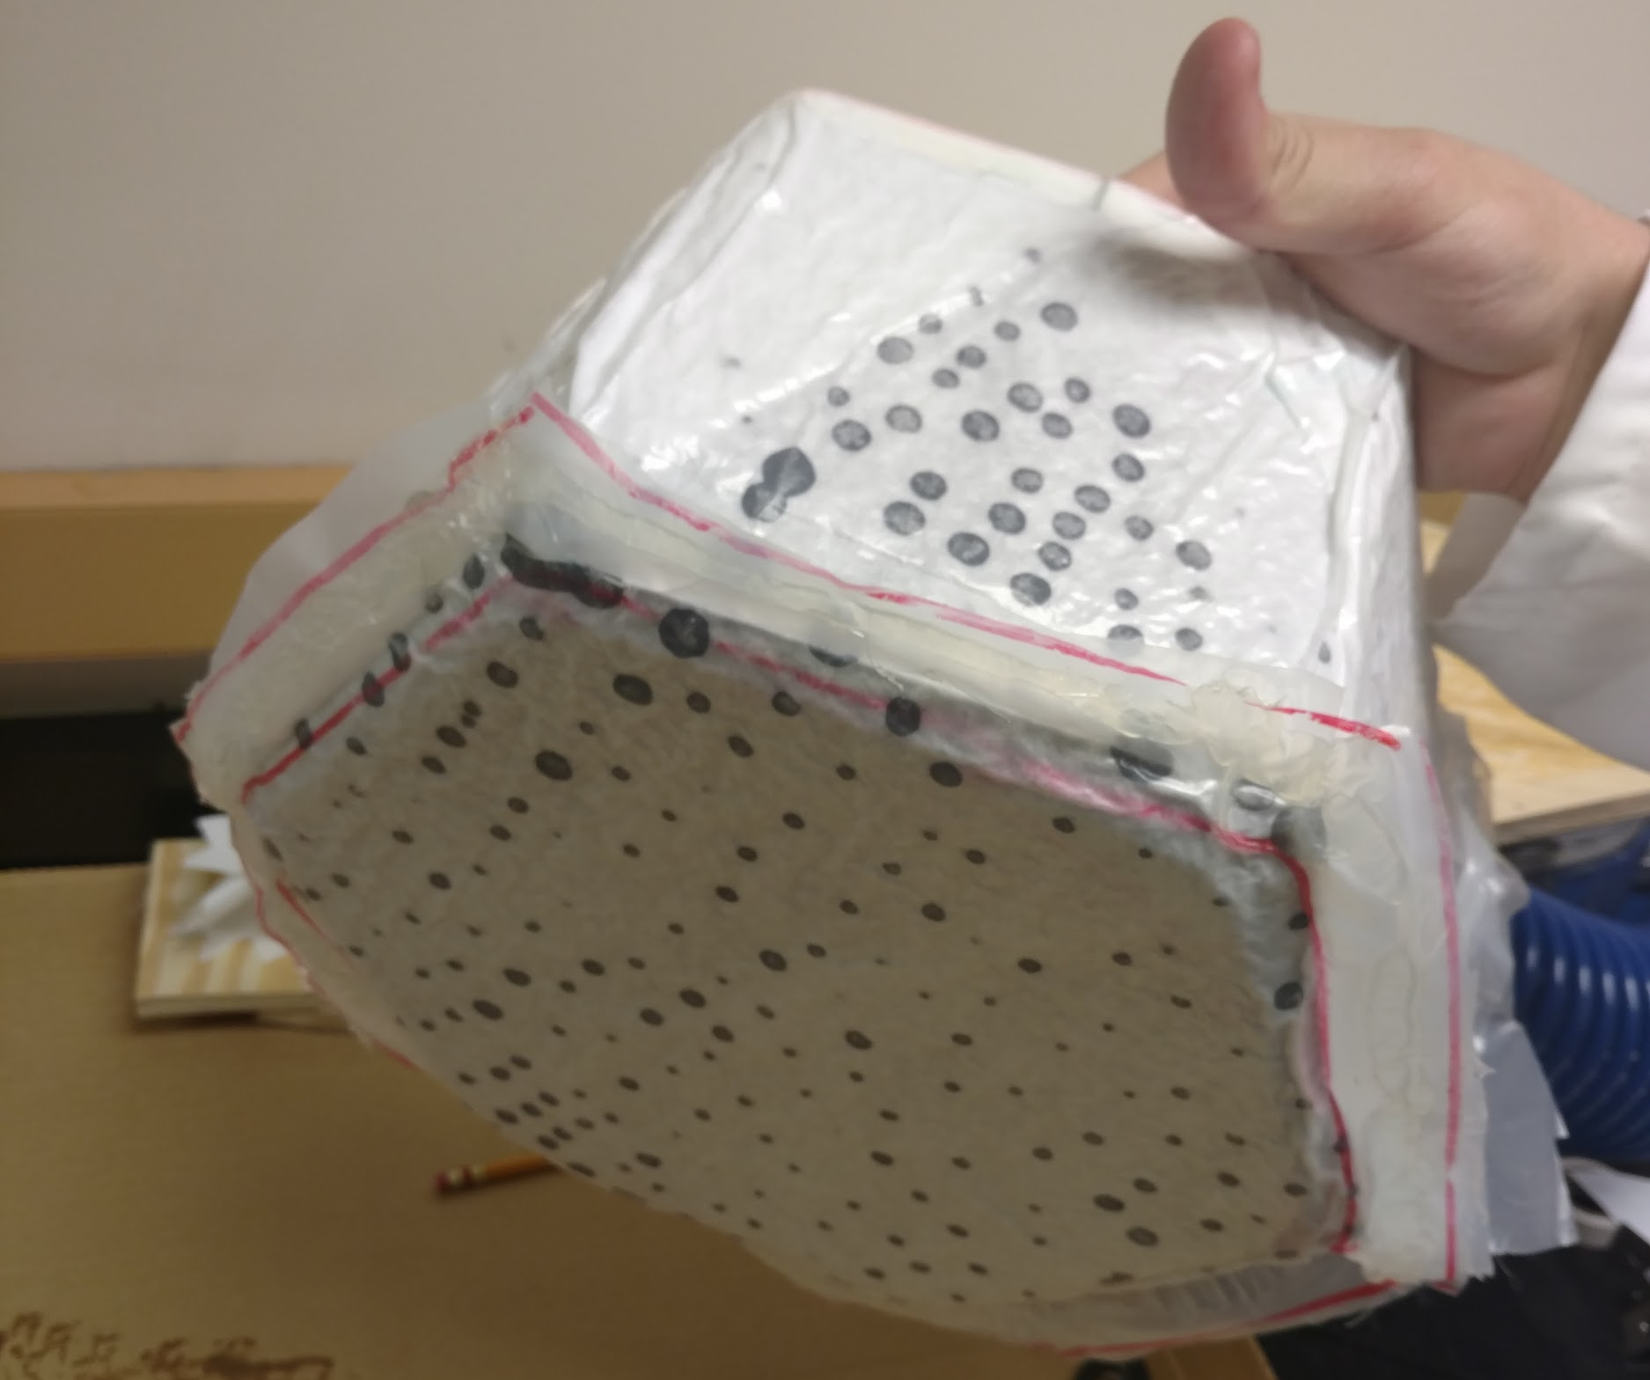
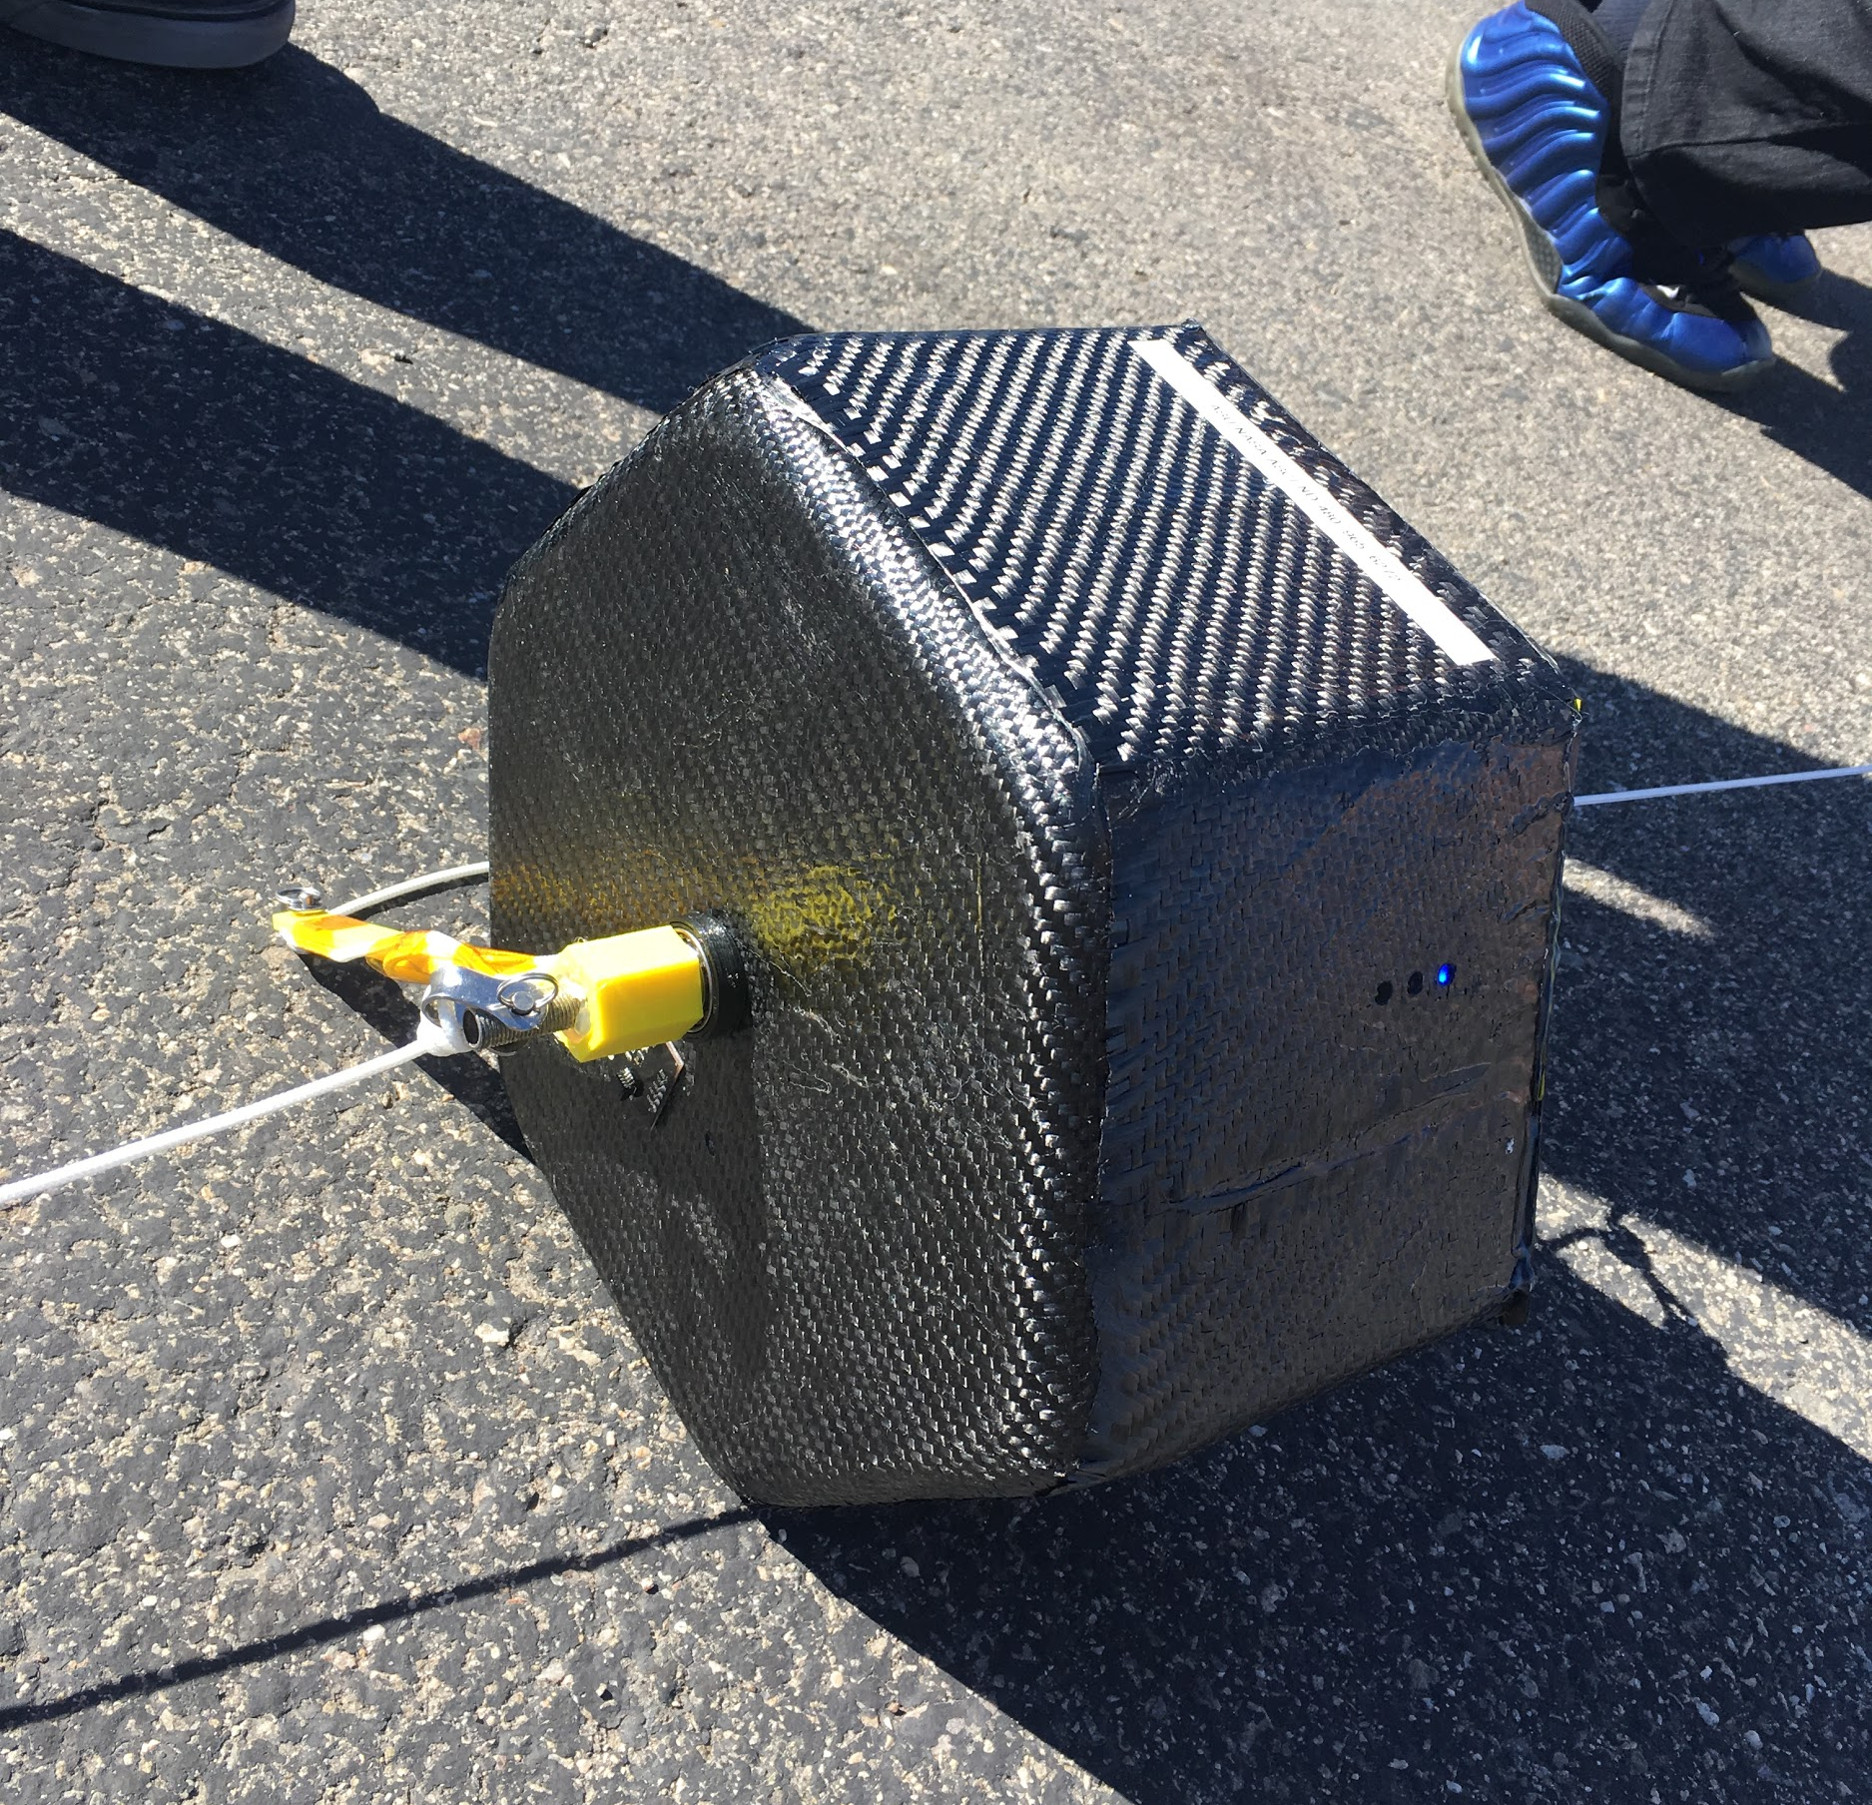
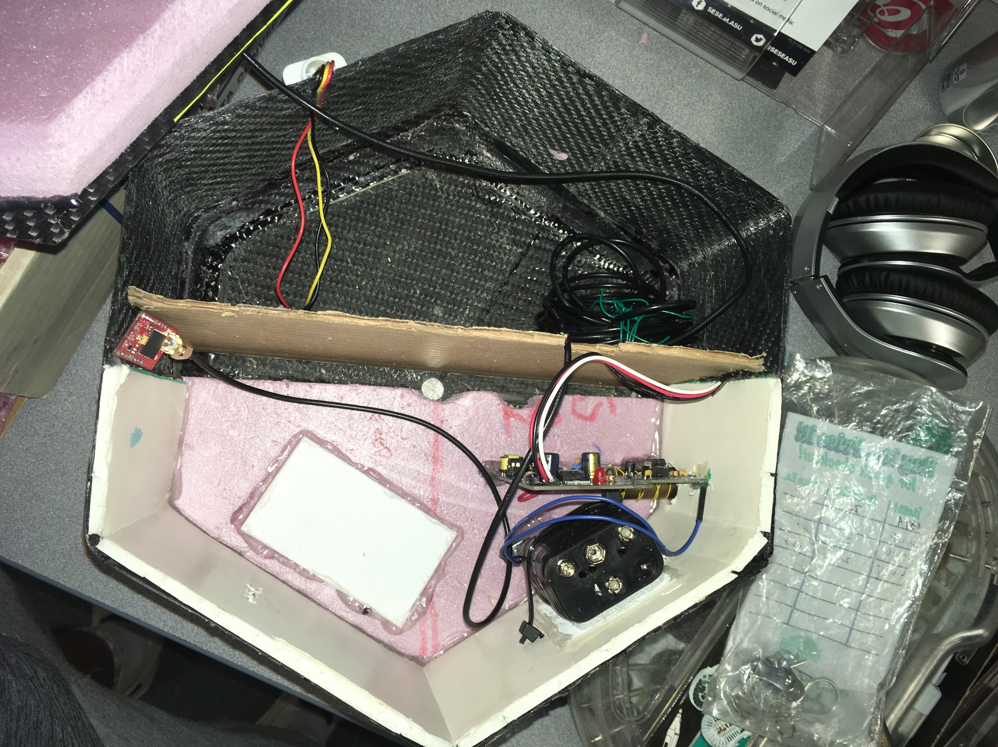
Spring Mechanical Engineering Process

Slide 9
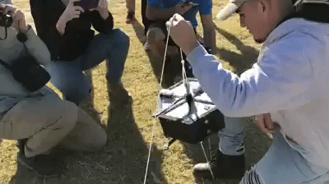
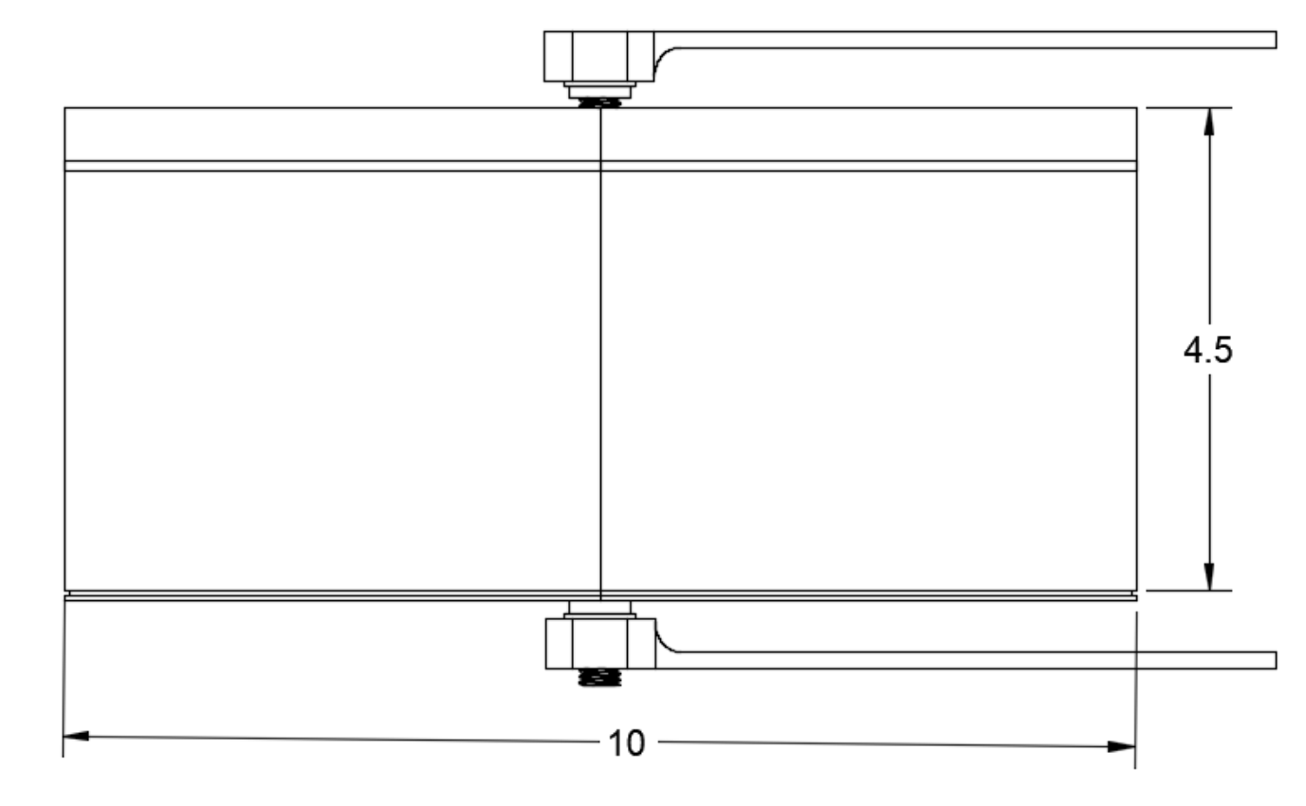
Rotation Stabilization Mechanism
3D printed part(s) sit on top of ball-bearing
Balloon tether guided around payload via 3D printed part(s)
Torque of tether spins 3D printed parts separate from the payload

Slide 10

Thank You!
Any Questions?
Special Thanks to:
Thomas Sharp, Desiree Crawl, Laura Zimmerman, Bianca Pina, Paul Ronquillo, Susan Brew, Arizona Space Grant, ANSR

